Slide 1
BT201
Biochemical Process Calculations
11/10/2022

Slide 2
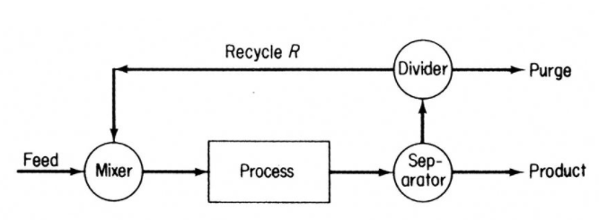
Purging
Purge: A stream bled off from a process to remove the accumulation of inerts or unwanted material that might otherwise build up in the recycle streams.
A problem may arise in processes that involve recycling.
Suppose a material (inerts or unwanted material) that enters with the fresh feed or is produced in a reaction remains entirely in a recycle stream, rather than being carried out in a process product.
If nothing were done about this situation, the substance would continuously enter the process and would have no way of leaving; it would therefore steadily accumulate, making the attainment of steady state impossible.
To prevent this buildup, a portion of the recycle stream must be withdrawn as a to rid the process of the substance in question.

Slide 3

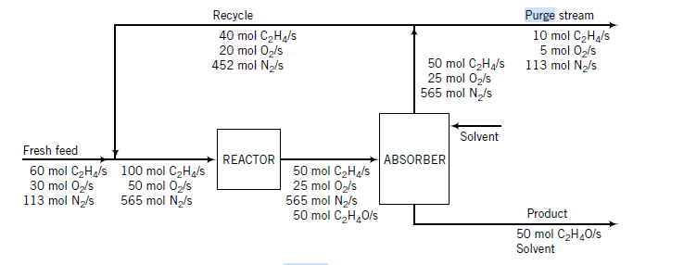
Purging: ethylene oxide
A mixture of ethylene and air constitutes the fresh feed to the process.
The effluent from the reactor passes to an absorber and is contacted with a liquid solvent. All of the ethylene oxide is absorbed into the solvent.
The gas stream leaving the absorber, which contains nitrogen and unreacted ethylene and oxygen, is recycled to the reactor.
If there were no nitrogen (or any other inert and insoluble substance) in the feed, there would be no need for a purge stream. The recycle would contain only ethylene and oxygen; the fresh feed would contain just enough of these substances to make up for the amount lost in the reaction, and the system would be at steady state.
However, there is nitrogen. It enters the system at a rate of 113 mol/s and leaves the system at the same rate in the purge stream.
If the system were not purged, nitrogen would accumulate at this rate until something—probably unpleasant—occurred to shut down the process.

Slide 4

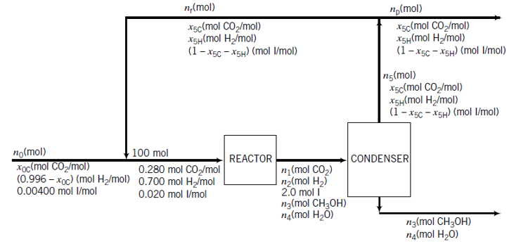
Recycle and Purge in the Synthesis of Methanol
The fresh feed to the process contains hydrogen, carbon dioxide, and 0.400 mole% inerts (I).
The reactor effluent passes to a condenser that removes essentially all of the methanol and water formed and none of the reactants or inerts. The latter substances are recycled to the reactor.
To avoid buildup of the inerts in the system, a purge stream is withdrawn from the recycle.
The feed to the reactor(not the fresh feed to the process) contains 28.0 mole% CO₂, 70.0 mole% H₂ , and 2.00 mole% inerts.
The single-pass conversion of hydrogen is 60.0%.
Calculate the molar flow rates and molar compositions of the fresh feed, the total feed to the reactor, the recycle stream, and the purge stream for a methanol production rate of 155 kmol CH₃OH/h.

Slide 5
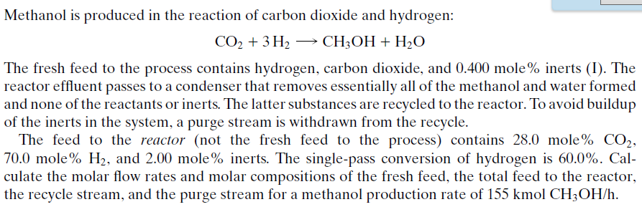
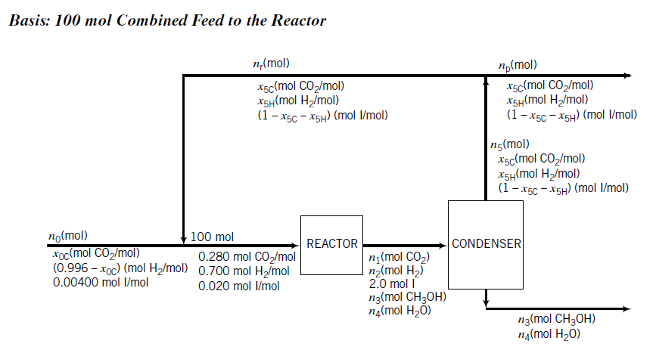

Slide 6
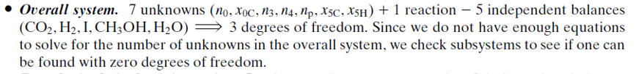
Degree-of-Freedom Analysis

Slide 7
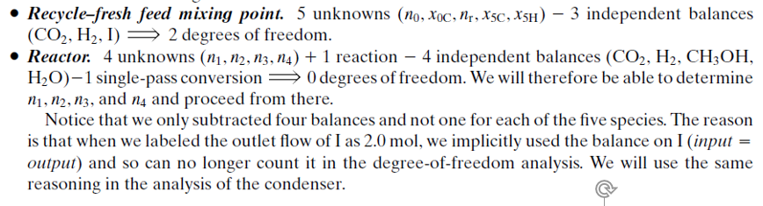

Slide 8
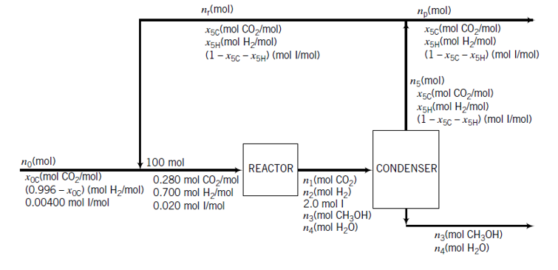
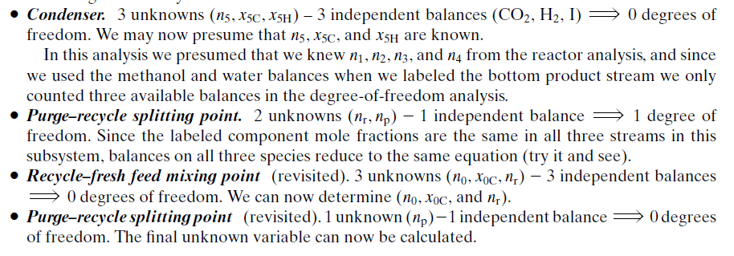

Slide 9
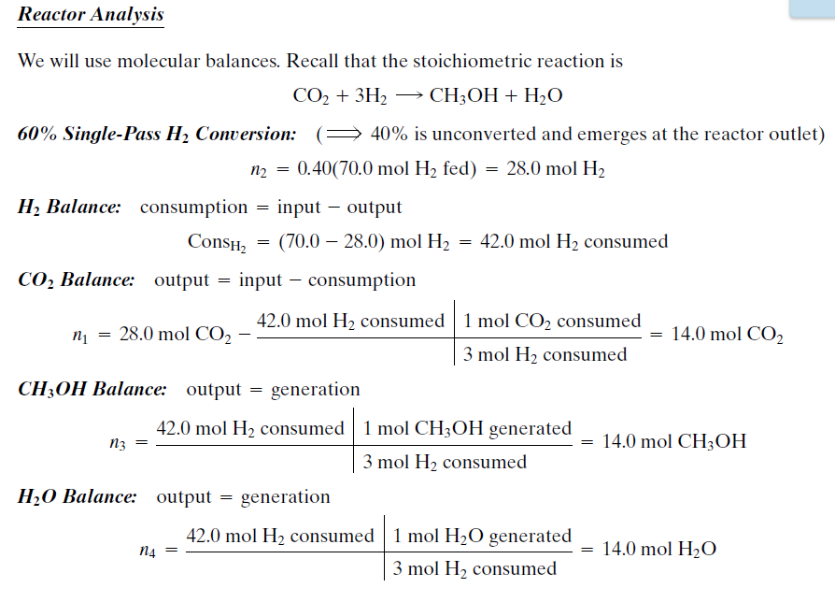

Slide 11
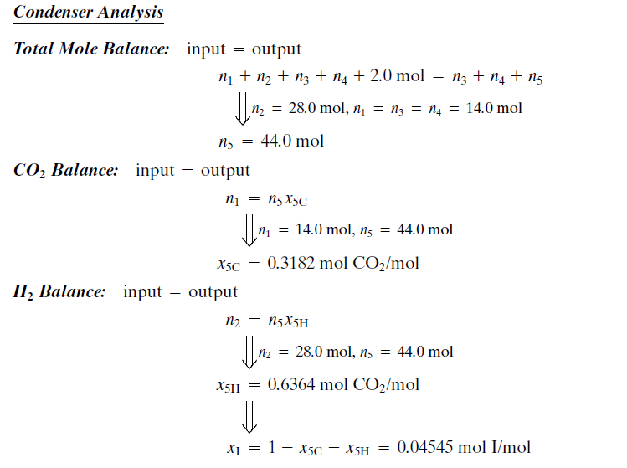

Slide 12
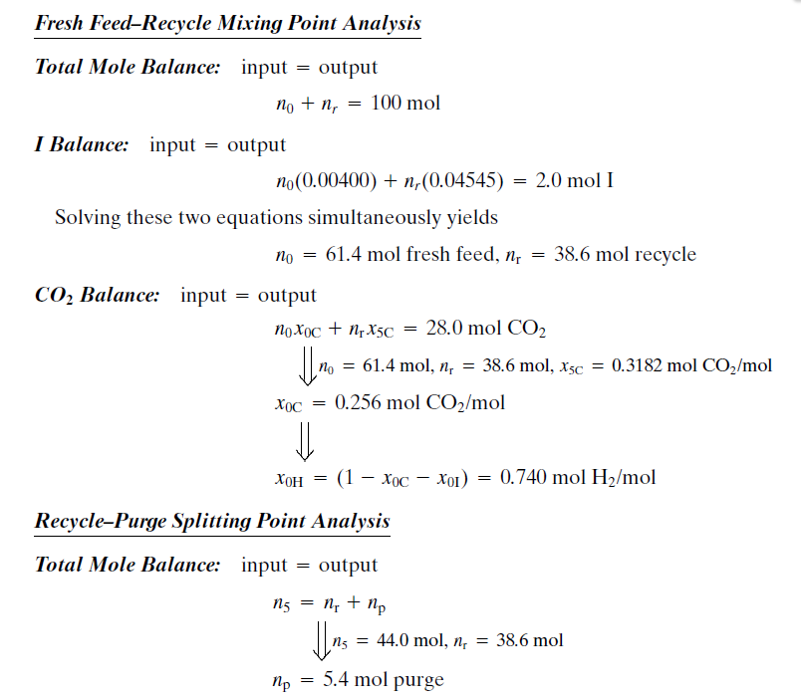

Slide 13
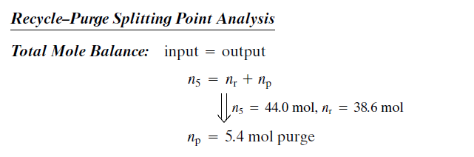

Slide 14
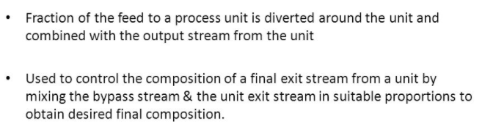
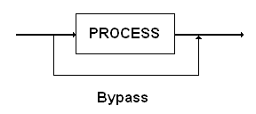
Bypass
By varying the fraction of the feed that is bypassed, we can vary the
composition and properties of the product.

Slide 15
Fresh orange juice contains 12.0 wt% solids and the balance water, and concentrated orange juice contains 42.0 wt% solids. Initially a single evaporation process was used for the concentration, but volatile constituents of the juice escaped with the water, leaving the concentrate with a flat taste. The current process overcomes this problem by bypassing the evaporator with a fraction of the fresh juice. The juice that enters the evaporator is concentrated to 58 wt% solids, and the evaporator product stream is mixed with the bypassed fresh juice to achieve the desired final concentration.
Draw and label a flowchart of this process, neglecting the vaporization of everything in the juice but water. First prove that the subsystem containing the point where the bypass stream splits off from the evaporator feed has one degree of freedom. (If you think it has zero degrees, try determining the unknown variables associated with this system.) Then perform the degree-offreedom analysis for the overall system, the evaporator, and the bypass–evaporator product mixing point, and write in order the equations you would solve to determine all unknown stream variables. In each equation, circle the variable for which you would solve, but don’t do any calculations.
Calculate the amount of product (42% concentrate) produced per 100 kg fresh juice fed to the process and the fraction of the feed that bypasses the evaporator.
Most of the volatile ingredients that provide the taste of the concentrate are contained in the fresh juice that bypasses the evaporator. You could get more of these ingredients in the final product by evaporating to (say) 90% solids instead of 58%; you could then bypass a greater fraction of the fresh juice and thereby obtain an even better tasting product. Suggest possible drawbacks to this proposal.

Slide 16
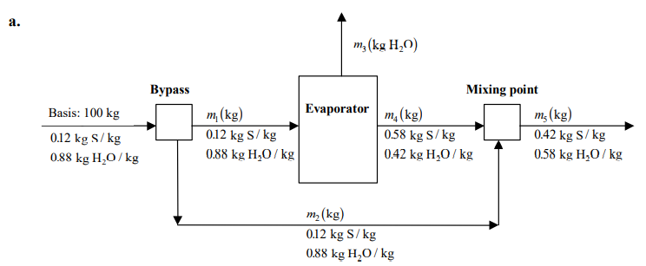
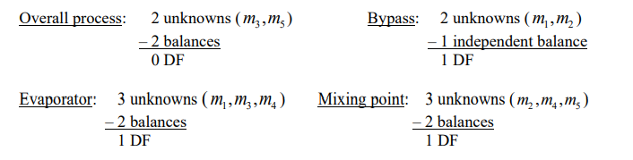

Slide 17
